Slide 1

Linear SVM – Soft Margin Classifier
Professor Bo Liu
James Watt School of Engineering

Slide 2
Linear SVM – soft margin classifier
In real scenarios, the datasets are not perfectly linearly separable due to outliers.
outlier
The idea of soft margin SVM:
Misclassification is allowed, but a penalty is given.
A trade-off between maximizing the margin and minimizing the number of misclassifications.

Slide 3


Linear SVM – soft margin classifier
Support vectors in non-separable case
Recall: the separable case has only one type of support vectors
  Ones that lie on the margin boundaries.
The non-separable case has three types of support vectors
  Lying on the margin boundaries
  Lying between the margin boundaries but still on the correct side
  Lying on the wrong side of the hyperplane.
$$H$$
class +1
$$H$$
class +1
1
3
2
class -1
1
2
3
class -1
linear separable case
linear non-separable case

Slide 4

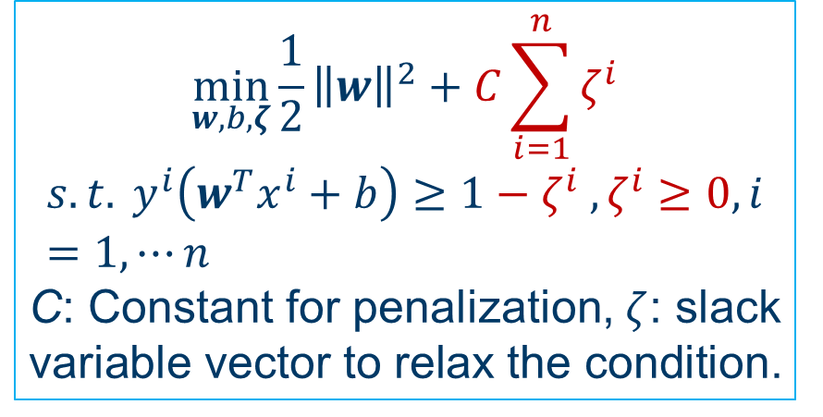

Linear SVM – soft margin classifier
The use of a slack variable to allow for margin boundary violation and misclassifications in the optimization problem.
class +1
$$H$$
violate the margin boundary
misclassified
class -1
$$\min_{w,b,ζ}{\frac{1}{2}{\left\|w\right\|}^{2}+C\sum_{i=1}^{n}{ζ^{i}}}$$
$$s.t. y^{i}\left(w^{T}x^{i}+b\right)≥1−ζ^{i} , ζ^{i}≥0, i=1, ⋯n$$
C: Constant for penalization, $ζ$: slack variable vector to relax the condition.
linear non-separable case
(optional)
$$\min_{w,b}{\frac{1}{2}{\left\|w\right\|}^{2}}$$
$$s.t. y^{i}\left(w^{T}x^{i}+b\right)≥1, i=1, ⋯n$$
(optional)

Slide 5
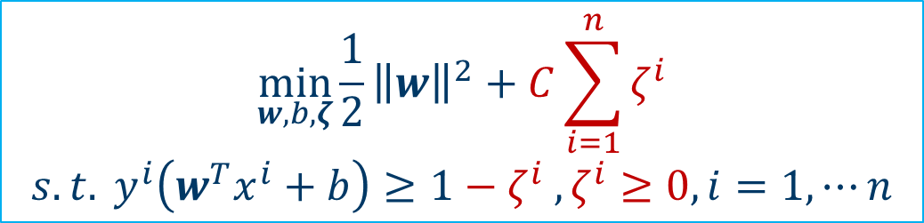
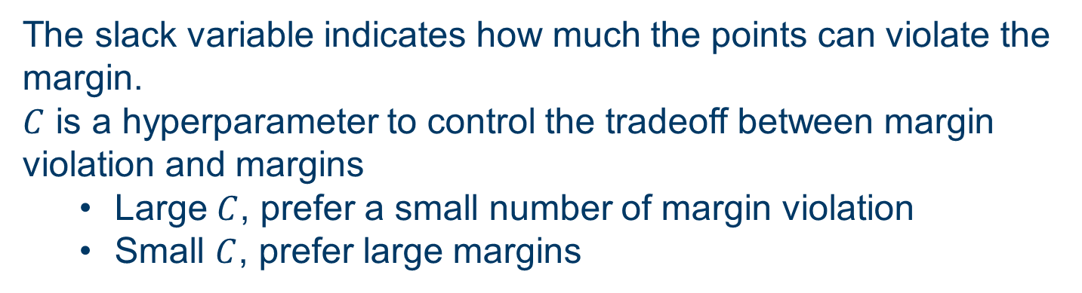
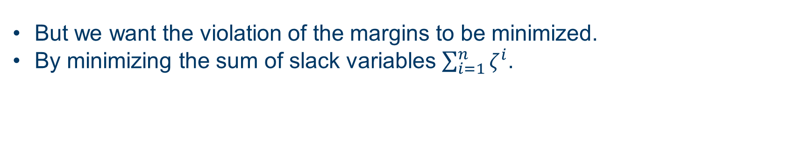
Linear SVM – soft margin classifier
The use of a slack variable to allow for margin boundary violation and misclassifications in the optimization problem.
But we want the violation of the margins to be minimized.
By minimizing the sum of slack variables $\sum_{i=1}^{n}{ζ^{i}}$.
penalty for margin violation
$$\min_{w,b,ζ}{\frac{1}{2}{\left\|w\right\|}^{2}+C\sum_{i=1}^{n}{ζ^{i}}}$$
$$s.t. y^{i}\left(w^{T}x^{i}+b\right)≥1−ζ^{i} , ζ^{i}≥0, i=1, ⋯n$$
See Support Vector Machines for Beginners - Linear SVM - A Developer Diary for a detailed derivation.
optional
The slack variable indicates how much the points can violate the margin.
$C$ is a hyperparameter to control the tradeoff between margin violation and margins
  Large $C$, prefer a small number of margin violation
  Small $C$, prefer large margins

Slide 6
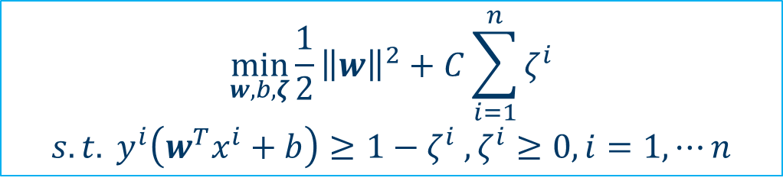
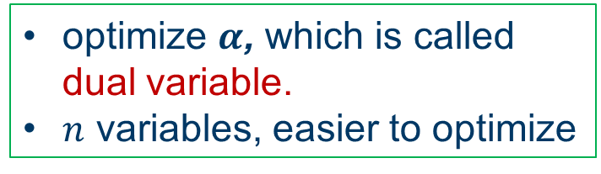
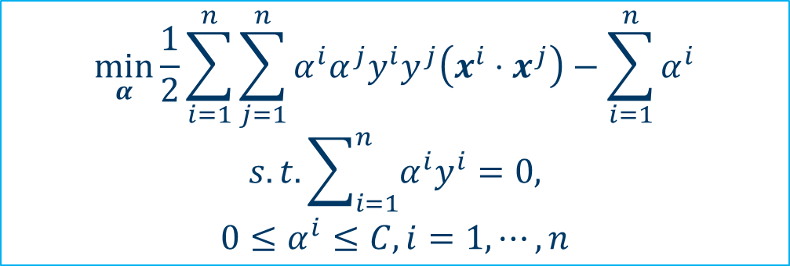
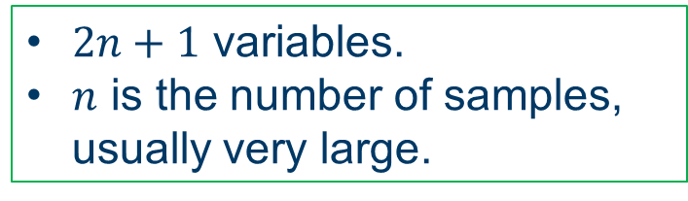
The primal and dual problems
optional
The optimization is often solved in through its dual problem. They are equivalent.
primal problem
$$\min_{w,b,ζ}{\frac{1}{2}{\left\|w\right\|}^{2}+C\sum_{i=1}^{n}{ζ^{i}}}$$
$$s.t. y^{i}\left(w^{T}x^{i}+b\right)≥1−ζ^{i} , ζ^{i}≥0, i=1, ⋯n$$
$2n+1$ variables.
$n$ is the number of samples, usually very large.
dual problem
optimize $α$, which is called dual variable.
$n$ variables, easier to optimize
$$\min_{α}{\frac{1}{2}}\sum_{i=1}^{n}{\sum_{j=1}^{n}{α^{i}α^{j}y^{i}y^{j}\left(x^{i}⋅x^{j}\right)−\sum_{i=1}^{n}{α^{i}}}}$$
$$s.t.\sum_{i=1}^{n}{α^{i}y^{i}}=0,$$
$$0≤α^{i}≤C, i=1,⋯,n$$
See Support Vector Machines for Beginners - Linear SVM - A Developer Diary for details.
The dual problem is optimized instead of the primal problem.

Slide 7
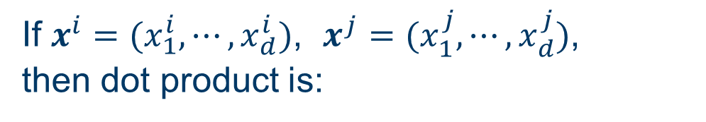
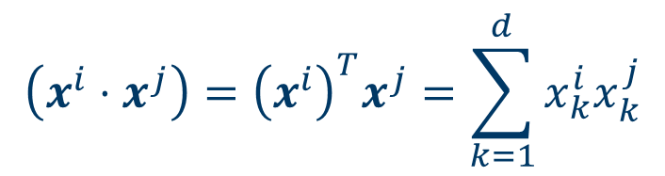
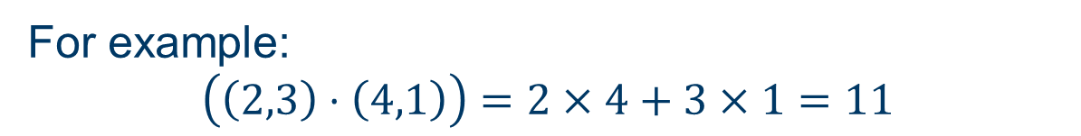
Dot product
The dot product is a mathematical operation between two vectors.
The result of dot product of two vectors is scalar.
If $x^{i}=(x_{1}^{i},⋯,x_{d}^{i})$, $x^{j}=(x_{1}^{j},⋯,x_{d}^{j})$,
then dot product is:
$$\left(x^{i}⋅x^{j}\right)={\left(x^{i}\right)}^{T}x^{j}=\sum_{k=1}^{d}{x_{k}^{i}x_{k}^{j}}$$
For example:
$$\left(\left(2,3\right)⋅\left(4,1\right)\right)=2×4+3×1=11$$

Slide 8

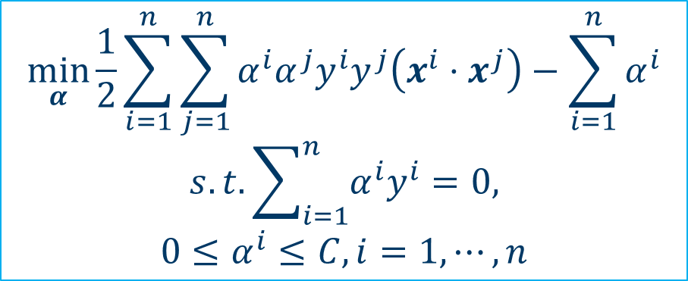



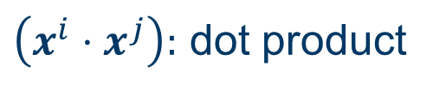

Linear SVM – soft margin classifier
optional
The optimization is often solved through its dual problem.
dual problem
$$\min_{α}{\frac{1}{2}}\sum_{i=1}^{n}{\sum_{j=1}^{n}{α^{i}α^{j}y^{i}y^{j}\left(x^{i}⋅x^{j}\right)−\sum_{i=1}^{n}{α^{i}}}}$$
$$s.t.\sum_{i=1}^{n}{α^{i}y^{i}}=0,$$
$$0≤α^{i}≤C, i=1,⋯,n$$
$\left(x^{i}⋅x^{j}\right):$ dot product
box constraint
feasible area is a box.
$$α^{2}$$
Box constraint: constraints that confine the variables within a range.
$$C$$
2D example
$$\left\{\begin{matrix}0≤α^{1}≤C, \\ 0≤α^{2}≤C \end{matrix}\right.$$
0
$$C$$
$$α^{1}$$

Slide 9
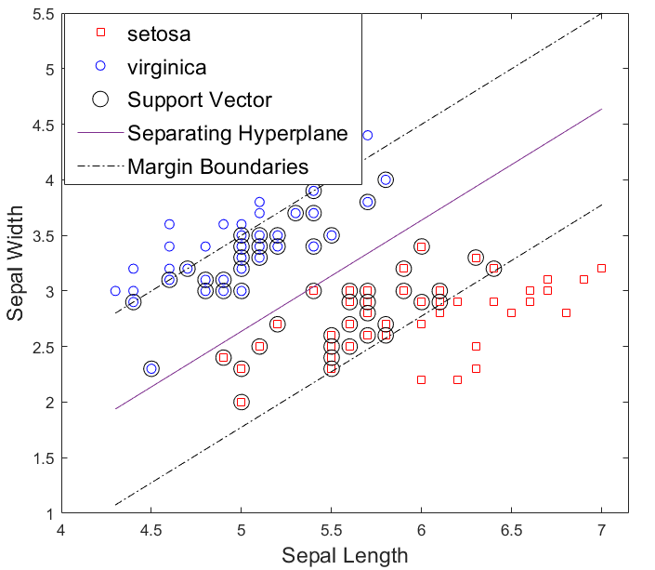
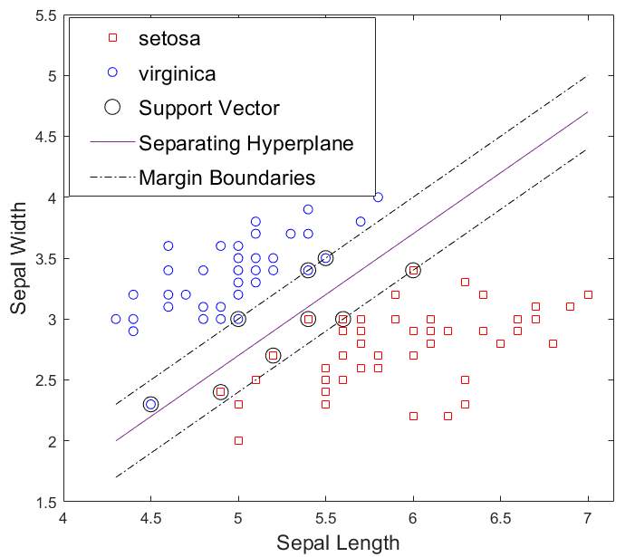
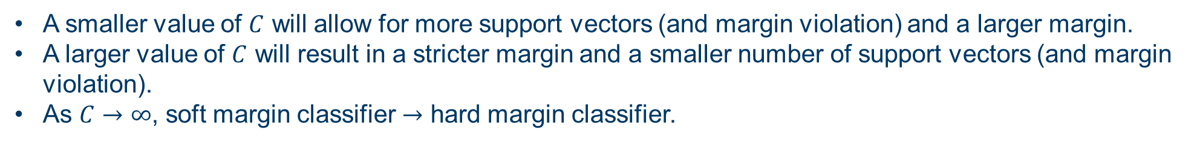


Linear SVM – soft margin classifier
Iris flower classification
$$C=0.0625$$
$$C=4$$
A smaller value of $C$ will allow for more support vectors (and margin violation) and a larger margin.
A larger value of $C$ will result in a stricter margin and a smaller number of support vectors (and margin violation).
As $C→∞$, soft margin classifier $→$ hard margin classifier.

Slide 10




Thanks!
#UofGWorldChangers
@UofGlasgow

